Slide 1


Clapton Solar and Storage
Mills County, TX
www.x-elio.com
#PositiveEnergy
Notes:
Thank you for joining us today. I hope this presentation will give you a better idea of who we are and a general project outlook.

Slide 2

Discover
X-ELIO

Slide 3

X-ELIO, global leader in
energy development
KEY FIGURES
+20
years of experience
+3 GW
of utility-scale
renewable energy projects built
+12 GW
of PV solar project pipeline
+9 GW
of Battery Energy Storage System pipeline
Your partner in the path to decarbonization

Slide 4
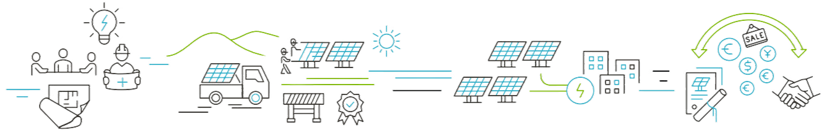
What we do
Development & financing
Promotion, development and financing of renewable (SOLAR & BESS) energy projects prior to their construction. Implementation of community, institutional and reputational engagement strategies.
Construction
X-ELIO manages project construction, from site planning to overseeing the work of EPC (Engineering, Procurement, and Construction) contractors responsible for the final build.
Operation and maintenance
Once the project is grid-connected, X-ELIO begins its role as operator, ensuring optimal performance. This involves monitoring operational efficiency based on climate conditions and managing financial deviations that could impact budgeted costs.
Commercialization
X-ELIO commercializes its assets through various methods, including buying and selling assets at any stage—whether under development or operational. This phase also involves establishing power purchase agreements (PPAs) and managing project revenues.

Slide 5
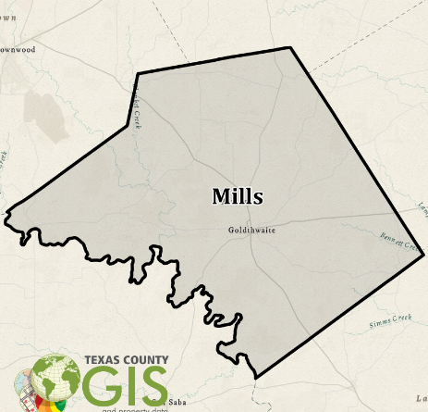
Clapton Solar LLC
Project Summary
ISO / Utility | ERCOT/Oncor
Installed Capacity | 260 MWp Solar + 200 MW BESS
Transmission Line | 345 kV
Project Investment Decision | Q4 2025
NTP / Start of Construction | Q2 2026
COD (Commercial Operation Date) | Q1 2028
Land acreage | ~1,600 acres
Capital Investment | $350MM
Construction / Permanent Jobs | 250-500 / 3-5
DISCLAIMER: dates and investment figures are to be used as estimations
Notes:
Yearly production (510,624 GWh/yr + 100MW BESS) Enough to power 77,000 homes annually
Q3 2026 break ground
~1600 acres

Slide 6
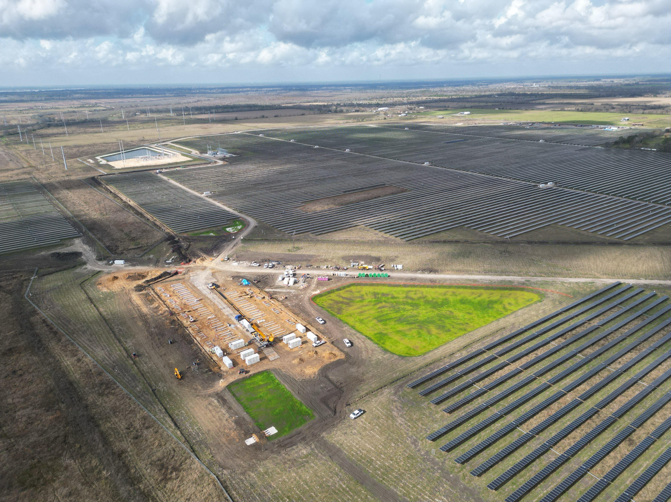
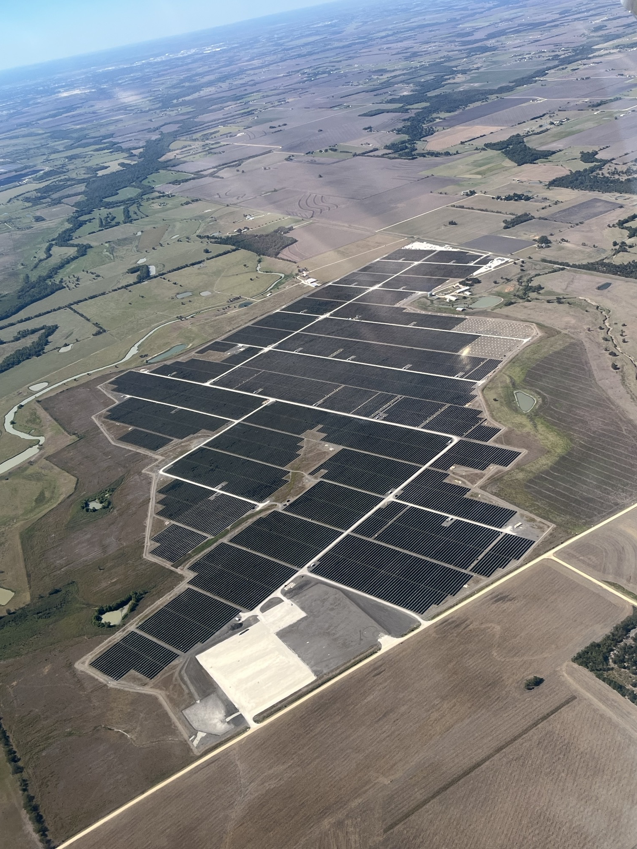
Photos of projects in development
Harris/Liberty County, TX
Bell County, TX

Slide 7
Key project benefits
Partnering for a Stronger, Reliable Energy Future
Strengthens grid reliability and energy independence by delivering clean, dispatchable power through partnerships between utilities, communities, and technology providers—ensuring affordable, resilient energy for the future.
Key Benefits of Solar and Battery Storage Projects
Grid Stabilization & Reliability
Alleviates pressure on the electric grid during peak demand.
Support local energy system resiliency.
Environmental Impact
Zero direct emissions or pollution.
Water-free energy
Economic Impact
Approximately $30 million in local revenue projected over 25 years.
$17 million to Mullin ISD
$13 million to County & RD & BR
Creates up to 500 construction jobs, plus 3-5 full-time contract positions for long-term operation and maintenance.
DISCLAIMER: figures to be used as estimations
Notes:
Improves grid stability by rapidly responding to fluctuations in energy supply and demand.
According to NERC, in 2024 there were times when batteries provided all of the capacity for frequency regulation services. Duration of outages declines with greater battery deployment.
Power source + battery provides rstability and reliability to grid during disruption

Slide 8
Energy Storage Safety
24/7 Monitoring
Continuous system monitoring ensures safe and reliable operation at all times.
Code Compliance
Designed and operated in accordance with all applicable codes and safety standards.
Fire Protection Standards
X-ELIO adheres to nationally recognized fire protection standards, including NFPA, using both active and passive fire safety measures.
Fire Suppression & First Responder Support
Each BESS includes its own built-in fire suppression system. X-ELIO will provide training and support to local first responders as needed.
Emergency Response Planning
Each site include a detailed safety and emergency response plan developed in alignment with OSHA guidelines.
Notes:
Continuous monitoring and reliability

Slide 9
Common Q&A for Solar and Battery Facilities
How noisy will the system be?
- The noise generated by a solar or energy storage installation is minimal and, in most cases, imperceptible to nearby communities, Solar panels: They do not produce any noise as they simply capture sunlight and convert it into electricity. BESS: Some may include cooling fans to maintain an optimal temperature. These fans produce a low noise level, comparable to a household air conditioner and are only audible at close range in addition the noise reduces as the distance increases.
Will panels crack? If so, will they leak harmful elements?
- Solar panels are designed to withstand extreme weather conditions such as hail, strong winds, and storms. Safety testing: Before installation, panels are rigorously tests, and their design prevents them from being easily damaged. Structural safety: They are made of durable materials, such as tempered glass and aluminum, which can withstand impacts without breaking easily, Materials inside the panels: The panel components are encapsulated within protective layers of glass and sealed polymers, preventing any chemical leakage and not dangerous to the environment.
Are Battery Electric Storage Systems (BESS) Harmful?
- No, BESS facilities are built to be safe and follow US Safety Standard to prevent Thermal runaway. Safety Standards: BESS units are mandated to follow the UL 9540A requirements that entail, separation distances, fire suppression systems, and emergency response plans. BESS Container Structure: NFPA Fire-rated walls/Installation, Explosion Relief Panels, Toxin Detection/containment and filtration system,
Notes:
Fire protection standards, NFPA
Technology isn’t what it once was
Controlled burn
Insurance at or above industry standard
UL-9540A tested by manufacturers warranty
State legislation passed by Gov Abbott related to fire safety
HB2834
HB3859
HB3229
Solar and BESS fastest ways to get power onto the grid
Diversification of energy mix during geopolitical events stabilizes energy prices

Slide 10





Our commitments
QHSSE
People & Culture
Compliance
Health and Safety is at the
vanguard of our efforts to be a responsible operator, committing to develop and implement all necessary actions to ensure safe and healthy conditions.
At X-ELIO, people is always at the forefront. We invest in outstanding people, making a difference by encouraging people to thrive.
We are strongly committed to
the highest international standards of integrity and to ensuring an ethical business conduct among our employees, investors and business partners.
Sustainability
Community Plan
We firmly believe that our
business model is the best driving force to foster economic recovery based on the highest sustainability criteria, with a strong commitment to greenhouse gas reduction and the fight against climate change.
Our company’s commitment to building meaningful relationships with the communities we are part of, becoming a tool and ally for environmental and socioeconomic development.

Slide 11





WHO IS X-ELIO?
WHAT KIND OF PROJECTS DO WE SUPPORT?
X-ELIO is a company specialized in sustainable energy development with global presence. We have 16 years of experience with more than 2.6 GW built. We are a world leader in renewable and sustainable energy, with a strong commitment to the reduction of greenhouse gases and the fight against climate change.
EDUCATION
ENVIROMENT
Actions that cov education development at all levels.
Actions that focus on the preservation and improvement of the ecosystem.
Elementary/Middle: excursions and sustainable interactive classes
High School: women in STEM University/Masters: scholarships, events, research centres, mentorships Professional local training: certification courses on pv installation/maintenance
Smart Towns Plan: PV in public buildings, energy efficiency improvement actions, electric car chargers
Flora and Fauna: conservation actions, re-population, centres of interpretation, environmental improvement, vegetation islands, beekeeping
Sustainable lifestyle: Rehabilitation and/or maintenance of natural spaces, bicycle paths
WHAT IS COMMUNITY PLAN?
COMMUNITY
Actions to achieve an eco-friendly life in community
HEALTH
Actions that target a healthy lifestyle and
humanitarian aid
Community Plan is a group of actions with Local and Regional scope that aim to enhance the quality of life, environmental and socioeconomic development in all the communities, we feel, we become a part of. We are eager to collaborate with you and come up together with the perfect meaningful and tailor-made project for your community.
Communal living: network of local agricultural and ecological trade, adaptation of facilities to people with disabilities, funding of communal green areas
Sustainable Tourism: funding of centres of interpretation for historical purposes, updating of touristic assets, roads, signs...
Healthy lifestyle: courses on the importance of a good quality of living, local sports teams with social goals, healthy food and nutrition courses Aid in extreme health - threatening events: food banks participations, donations to local health centres
Notes:
Community engagement plan
Involved partner in community
Environmental management plan
Protect local wildlife, ecological resilience
Community plan – determine needs of community
ISD – school supplies, laptops
Fire dept. – fire training, materials, firetruck
Proactively engaged with neighboring landowners

Slide 12
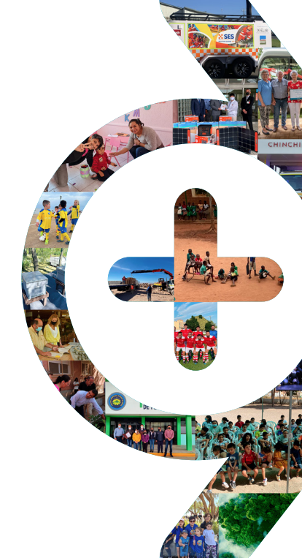
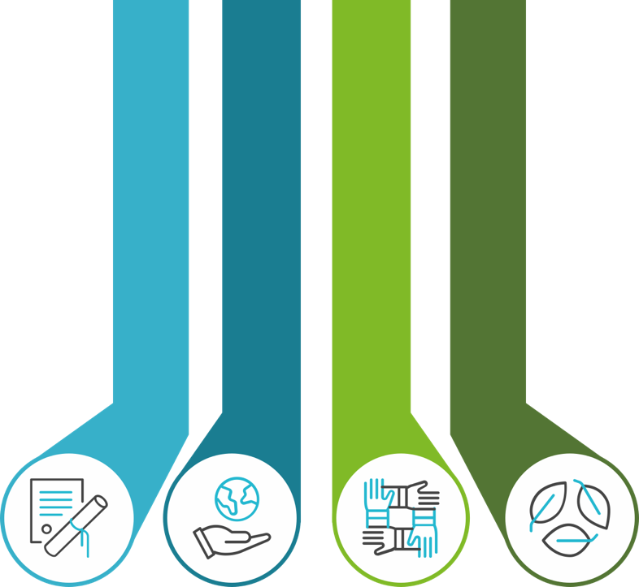
Community & Nature Plan
Our commitment to creating a lasting and positive impact on the communities and the natural environment we are part of.
Community Plan Actions
Our Community and Nature Plan is a required component of energy project we develop, helping drive positive impacts on local communities and environment.
We design our Community Plan Actions in collaboration with local leaders to address specific needs - prioritizing local jobs, suppliers, and community partnerships.
Our Nature plan aims to protect and enhance local wildlife and native plants, supporting ecological resilience
All our Community Plan Actions are based on X-ELIO´s pillars of Environment, Education, Health and Communities and indicators
COMMUNITIES
ENVIRONMENT
HEALTH
EDUCATION
COMPLIANCE & SUSTAINABILITY

Slide 13
Contact us
Tom Dubel
Project Consultant
tdubel@cirrusadvisors.com
Luke Barber
Project Development Manager
luke.barber@x-elio.com
Address: 1000 Main St, Ste 2300
Houston, TX
www.x-elio.com
#PositiveEnergy
Notes:
Avoid uncertainties for investors and county
Unencumbered tax dollars
No seats in schools, no more cars on roads, no using county resources. Just check in the mail
Cooperation with brown County
Fire dept
Mullin closest town

